Slide 1
Living labs demo:
Observata
Maka Eradze
25.11.17

Slide 2
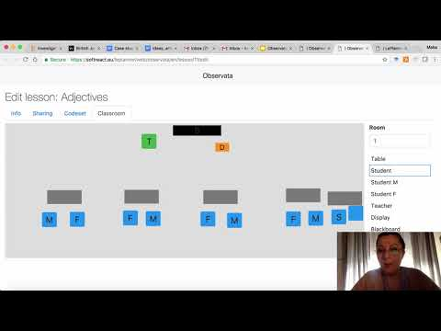
DEMO

Slide 3
What it is
Observata is a lesson observation tool under development that produces LA compliant data with specific context and lesson scenario. It is directed at observing events during the implementation of lessons and activity tracking. Coding can happen with activity-driven or theory (pedagogy)-driven codes, predefined or open coding.
Pros: Can speed up observation and coding process, can visualize observation data right away, produce xAPI statements, export data for MMLA
Cons: As of now, limited functionalities, under development , needs readjustment and training to do the observations this way

Slide 4
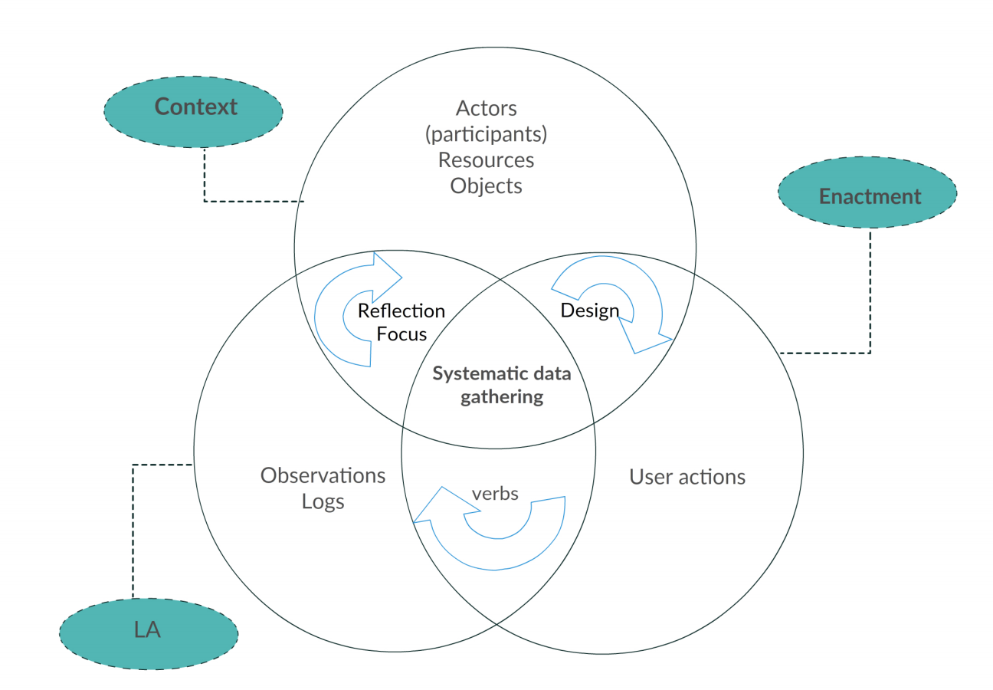
Observata can:
Take the learning design and context from Lesson Scenario (resources, teacher intentions)
Define foci of interests (actors, verbs and objects)
Observe events in a lesson scenario enactment and code for later analysis
Produce observation data in computational format (xAPI statements for Multimodal Learning Analytics)
Do from highly structured to unstructured observations → predefined to open coding
Visualize coded events on a timeline
Export data
Learning Analytics Model for Lesson Observations

Slide 5
Under Development
Future plans:
Learning Analytics Dashboards
More sophisticated visualization of transcripts
Compare transcripts from different observers

Slide 6
How to get it
Not yet available as a stable version. Developed by TLU, as a part of the doctoral thesis (Maka Eradze)
https://softreact.eu/leplanner/web/observata/en/
Contact: maka@tlu.ee

Slide 7
European Union’s Horizon 2020 research and innovation programme grant agreement No. 669074 (CEITER)

